Slide 1
Categorization of User News Interest Based on the Tweets
Team Members
Gowtham V
Akshay V
Praveen Siva

Slide 2
Problem Statement
This Project mainly aims at the categorization of the user’s interest based on the current news on which the user is tweeted. This enables to provide the user interested news which eventually increase the user enhanced environment.

Slide 3
Dataset Processing
The CrisisLexT6 dataset consist of 6 different catastrophe based tweets. In this combined each of the catastrophe based tweets into a single one with catastrophic names as the labels.
There are six labels they are
2012 Sandy Hurricane
2013_Alberta_Floods
2013_Boston_Bombings
2013_Oklahoma_Tornado
2013_Queensland_Floods
2013_West_Texas_Explosion
random

Slide 4
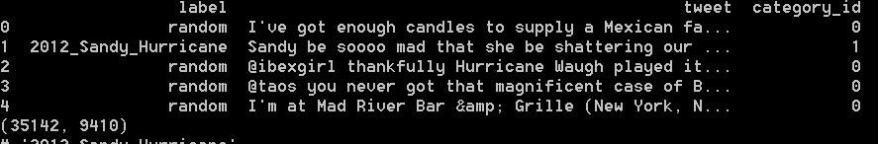
Screenshot of after preprocessing

Slide 5
Algorithms involved
After the preprocessing of data the dataset is incurred to the following algorithms
Linear SVM
Logistic Regression
Multinomial Naïve Bayes
Random Forest Classifier
Among those Linear SVM Gives an accuracy of 82 percent.

Slide 6
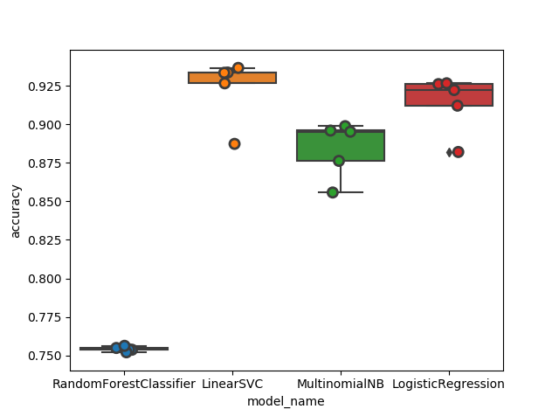
Algorithms Accuracy Visualization graph

Slide 7
Result
The Confusion Matrix is generated for the labels with the help of the model built using the support vector Machine
The Classifier Makes a prediction with an accuracy of 82 %
Accuracy achieved by other by other classifiers are
Linear SVM 0.82289
Logistic Regression 0.792297
Multinomial Naïve Bayes 0.688519
Random Forest Classifier 0.443826

Slide 8
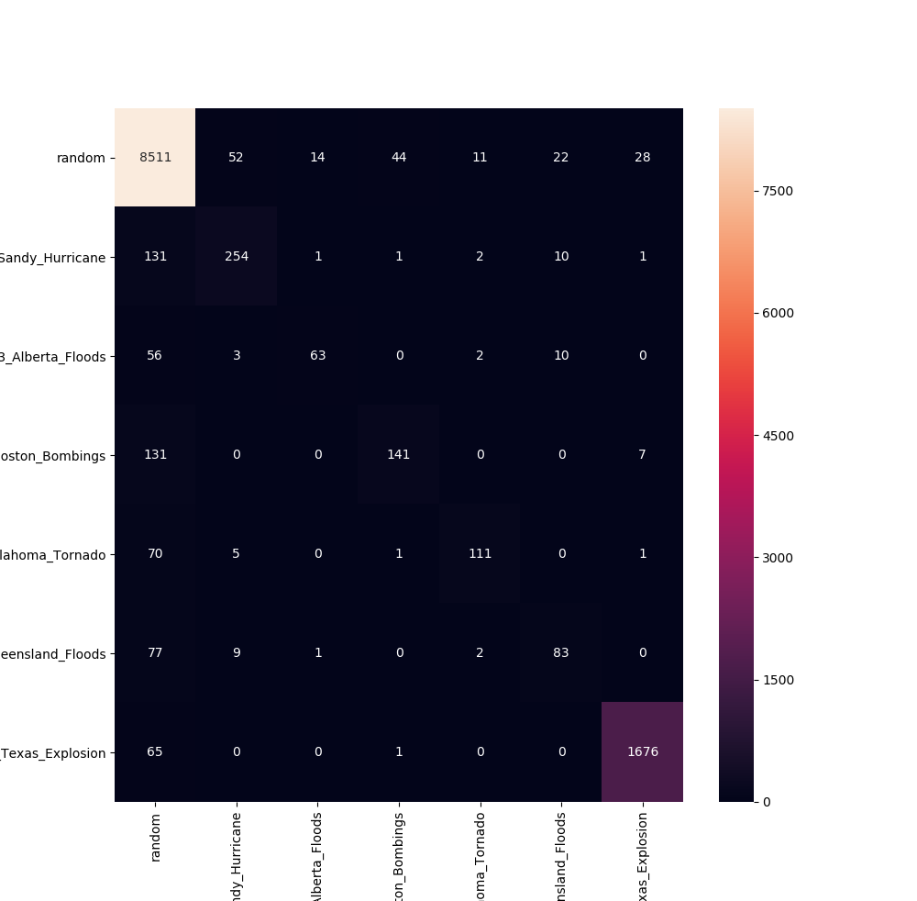
Confusion Matrix

Slide 9
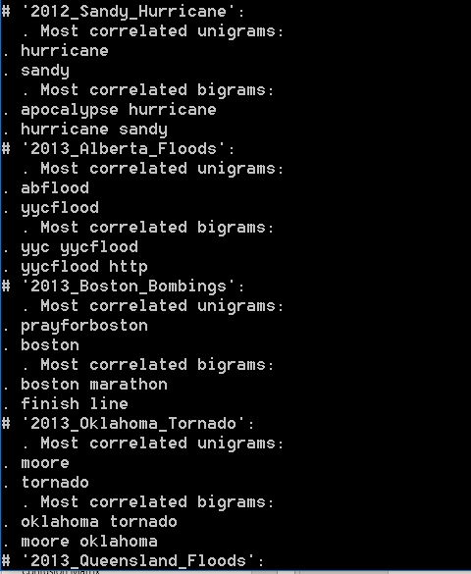
Unigrams and Bigrams Generated

Slide 10
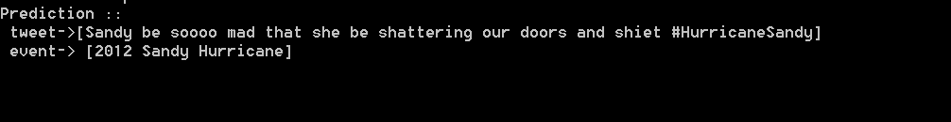
Final Prediction Output

Slide 11
Thank You
_/|\_

